Slide 1
PostgreSQL Query Execution Process
CATs
Lauro Ojeda
Paula Berenguel

Slide 2
PostgreSQL Planner

Slide 3
Understanding Query Execution Process
Foundation of Optimization
Understanding how the database optimizer chooses access paths and uses indexes.
Identifying Bottlenecks
Gaining insights into data processing to pinpoint performance issues.
Effective Tuning Strategies
Applying precise optimizations based on the execution process rather than guesswork.

Slide 4
Query Execution in a nutshell
Client sends SQL query
The planner works out the fastest path to fetch data
Executor pulls data from shared buffers or disk
Results streamed back to client
Parsing
Rewriting
Planning
Execution

Slide 5
Step 1: Client Issues Query
Query arrives via PostgreSQL wire protocol (libpq)
Backend process is assigned to the connection
Query enters "frontend/backend" communication pipeline

Slide 6
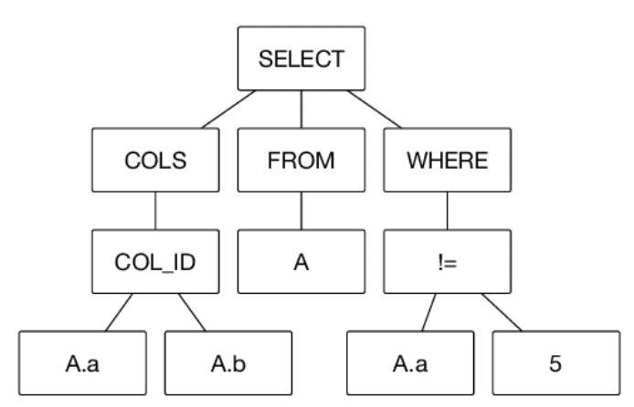
Step 2: Parsing & Syntax Checking
Parser validates SQL grammar and structure
SQL is transformed into an initial parse tree
Semantic checks: objects, types, privileges
Errors at this stage: syntax errors, unknown identifiers

Slide 7
Step 3: Query Rewrite Phase
Rule system rewrites parse tree (views, rules)
Produces logical query tree prior to planning
Ensures logical correctness before planning

Slide 8
Step 4: Query Planner — Overview
Definition: Cost-based component that chooses the cheapest valid execution strategy for a query using statistics and path exploration
Converts query tree into an efficient execution plan
Uses a cost‑based optimization approach
Generates multiple possible strategies (“paths”)
For each path, estimates CPU cost, I/O cost, row counts
Identifies the JOIN strategy possibilities and estimate their cost

Slide 9
Planner Mechanics: Cost-Based Optimization
Cost model estimates the cost for:
Seq scans
Index scans
Joins (nested loop, hash join, merge join)
Sorts and aggregation
Based on statistics (pg_stats): histograms, n_distinct, correlation
Uses sampling-based planning for large tables

Slide 10
Planner: Plan Generation & Path Selection
Evaluates multiple possible join orders
Uses dynamic programming for join order optimization
Chooses cheapest path based on total estimated cost
Final output: Plan Tree, including scan nodes, join nodes, filters

Slide 11
Step 5: The Executor — Overview
Executor receives the plan tree from the planner
Walks the tree node by node (bottom to the top)
Executes each node: scan → filter → join → aggregate
Returns tuples back up through parent nodes

Slide 12
How PostgreSQL Fetches Data (Disk & Memory)
Executor requests data
Buffer Manager checks Shared Buffers if data is in memory
If miss: brings data from disk into buffers
If memory pressure: OS may swap least-used pages
Executor
Shared buffers
Disk (Data Files)
OS Swap (optional)

Slide 13
Buffer Manager & Shared Buffers
Shared Buffers = main PostgreSQL memory cache
All data reads/writes pass through shared buffers
Background writer flushes dirty pages
Checkpoint ensures data persistence to disk
Eviction policies manage cache under memory pressure

Slide 14
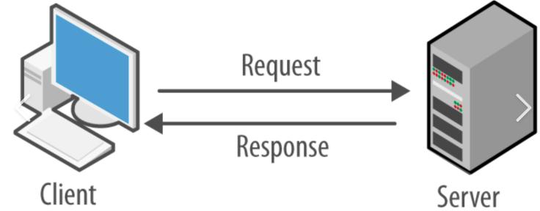
Data which is ready, goes back to the client

Slide 15
Interpreting the Execution Plan

Slide 16
What’s an Execution Plan?
An execution plan describes how the database runs a SQL query, including the order of operations, access methods, and join algorithms, and understanding it helps identify performance issues such as inefficient joins, incorrect row estimates, or missing indexes so you can optimize the query or schema to improve speed and resource usage.

Slide 17
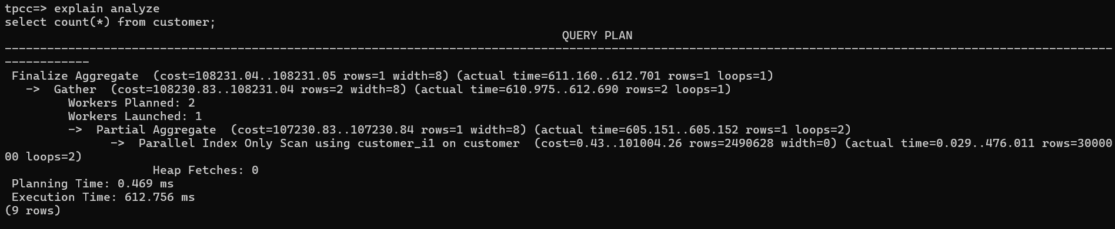
Execution Plan components 1
PostgreSQL plan is a hierarchical tree of nodes
Each node produces tuples for its parent node
Each node can be identified by the right arrow in the EP
Types of nodes:
Compute operations: Gather, Sort, Aggregate, Hash
Execution methods: Sequential Scan, Index Scan, Index Only Scan, Bitmap Heap/Index Scans,
Join Nodes

Slide 18
Execution Plan components 2
compute operation: type of compute work necessary to merge, aggregate, filter, sort, etc
execution method: how Postgres will fetch the data in the relation
cost: statistics computed cost of each operation (startup..total cost)
actual time: the time spent by the operation (startup..total time)
rows: amount of rows returned by the node to the parent node
loops: how many iterations the operation made to fetch rows=? rows
compute operation
actual time
rows
loops
cost
execution method

Slide 19
Execution Plan components 3
Operations summary
Planning time: time spent by the planner to workout multiple execution plans until deciding which of the evaluated plans is considered optimal
Execution time: The actual total time spent in both planning and executing the query.
Transfer time: not listed in the EP as dependant to the network settings. It is the time the data is returned to the client

Slide 20
How to Interpret EXPLAIN / EXPLAIN ANALYZE
EXPLAIN shows the chosen execution plan
EXPLAIN ANALYZE shows real execution stats
It will execute the query but will suppress data output
Displays the planning and execution time
EXPLAIN (ANALYZE, BUFFERS) shows the above PLUS memory and disk buffers reads
Real vs estimated analysis reveals planning accuracy
Evaluate the time spent per each node; start working towards reducing the actual time spent per node
Usually, I go straight to the node which takes the longest
Tip: multiply the actual time per node with the loops

Slide 21
Common relations operations
Sequential Scan → reads entire table
Index Scan → uses B‑tree index for targeted reads
Bitmap Scan → efficient for many scattered hits
Nested Loop → good for small input sets
Hash Join → best for large joins, requires memory
Merge Join → sorted inputs, efficient for ordered data

Slide 22
Examples
-- sequential scan
explain analyze
select * from customer;
-- aggregation
explain analyze
select count(*) from customer;
-- index scan
explain analyze
select * from customer where c_id=1000;
-- join
explain (buffers, analyze)
select c.c_first||' '||c.c_last customer, c.c_balance, h.h_date, h.h_amount, h.h_data
from customer c join history h on (c.c_id=h.h_c_id and c.c_d_id=h.h_c_d_id and c.c_w_id=h.h_c_w_id)
where c.c_id=1000 and c.c_d_id=6 and c.c_w_id=66;

Slide 23
Example – tuning in action 1
The common mistake. Query executing 1000’s times per min.
-- EP execution time ~ 250ms
explain (buffers, analyze)
select c.c_first||' '||c.c_last customer, c.c_balance, h.h_date, h.h_amount, h.h_data
from customer c join history h on (c.c_id=h.h_c_id and c.c_d_id=h.h_c_d_id and c.c_w_id=h.h_c_w_id)
where c.c_id=1000 and c.c_d_id=6 and c.c_w_id=66;
Check the amount of data returned by the query: if too much data, reduce the amount of data returned
Look into table’s definitions to see if there’s something missing
What’s the solution?
create index history_i1 on history (h_c_w_id, h_c_d_id, h_c_id);

Slide 24
Example – tuning in action 2
Disk spillage issue.
-- EP execution time ~ 900ms
EXPLAIN (ANALYZE, BUFFERS, SETTINGS)
SELECT c.C_ID, c.C_LAST, ol.OL_I_ID, ol.OL_AMOUNT, ol.OL_DIST_INFO, c.C_DATA
FROM
ORDER_LINE ol
JOIN CUSTOMER c ON (ol.OL_W_ID = c.C_W_ID AND ol.OL_D_ID = c.C_D_ID)
WHERE
ol.OL_W_ID = 1 AND ol.OL_D_ID = 1 AND c.C_ID <= 5
ORDER BY c.C_LAST desc;
Look at sorting node…
What’s the solution?
Increase work_mem
Disk is getting better – disks are almost as fast as memory

Slide 25
Example – tuning in action 3
The column type conversion
-- EP execution time ~ 180ms
EXPLAIN (ANALYZE, BUFFERS, SETTINGS)
SELECT o_id, o_c_id, o_d_id, o_w_id, o_entry_d
FROM orders
WHERE o_c_id = 3000
AND o_w_id::text = '1'
AND o_d_id = 1
ORDER BY o_id;
Look at tables definition…
Why isn’t it using the index?
What’s the solution?
Casting is not needed, and its avoiding the index to be used.

Slide 26
TIPS!
Good STATISTICS are essential for generating good plans
In rare cases one may need to influence the optimizer by using query hints (unusual)
The page explain.dalibo.com is excellent for visual explain plan!
Focus in reducing time on the most expensive query nodes first
Duplicated indexes can create a real performance nightmare
Index is GREAT, but DON’T OVER-INDEX!

Slide 27
Summary & Key Takeaways
Multi-phase pipeline: parse → rewrite → plan → execute
Planner is statistics-driven and cost-based
Executor accesses data via shared buffers, heap, indexes and than disk
Use EXPLAIN/ANALYZE to diagnose and tune performance
Understanding execution plans is essential for performance tuning

Slide 28
THANK YOU!

